Slide 1

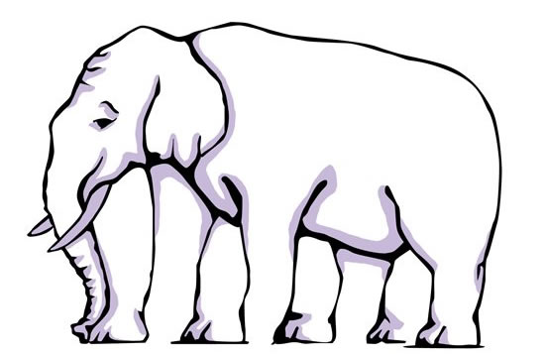
Can or Should We Always Believe What We See?

Slide 2
Introduction:
This assembly aims to focus on the idea of looking v seeing and the start of what it means to be compassionate: (e.g. to recognise that others might have feelings different to our own).
You might wish to have a brief warm-up conversation with pupils about the difference between seeing and looking (and hearing/listening as well possibly?).
George Berkeley gave his name to the famous US university Berkeley. He is a famous philosopher who argued that objects such as computers and chairs are things that are perceived or imagined in the mind. As a result, something cannot exist without it being perceived. (This might be too challenging for younger children but the older child, in my experience, love thinking about this concept).
Moving on from this idea of seeing, or things being real, is a more concrete example. The idea of ‘Gestalt’ theory (the word is German for ‘shape’ or ‘form’). It is a good way of explaining that our mind makes us ‘see’ things that aren’t really there….like the example of the triangle given.
If our mind is capable of fooling us, we need to think much more carefully about what we see(and therefore believe) and therefore question its truth sometimes….
This might be important in the playground for example when we fall out with our friends… is there another way to look at our problem / are we right?. Can we be the problem-solver?

Slide 5
Gestalt Theory

Slide 6
Gestalt Theory
It is not there yet your eyes and brain fill in the gaps.
We do not need to see and physically experience things to perceive them…

Slide 7
Gestalt Theory
It is not there yet your eyes and brain fill in the gaps.
We do not need to see and physically experience things to perceive them…

Slide 8
Gestalt Theory
It is not there yet your eyes and brain fill in the gaps.
We do not need to see and physically experience things to perceive them…

