Slide 1
Introduction:
The aim of this assembly is to look at the concept of generosity and mercy. The word Mercy (same root as the French word ‘Merci’) means ‘grace or ‘wages or reward’). It is taken from the bible theme ‘Faith, Hope and Love’ but could easily stand on its own without this link. It can be seen as interconnected, just like a spider’s web.
Mercy Ships is a global charity doing extraordinary work, currently on the west coast of Africa and other areas around the world.
Psychologists, including Dr Martin Seligman (Positive Psychology) believe that feelings of gratitude and generosity towards others play a very big part in our own wellbeing.
This assembly introduces the idea to children that large numbers of people choose to give their time and skills freely because they value and are grateful for the skills they have (gratitude) and importantly, they recognise the needs of others who are less fortunate they themselvesn(generosity).
The title of this assembly “What Do We Stand For” is a play on words but asks children a crucial question. Unlike Ulrich, they have legs and can move freely (they have many other skills besides which they may well also take for granted)…Who could benefit if they put all of these skills to good use (and showed gratitude and generosity?)

Slide 2
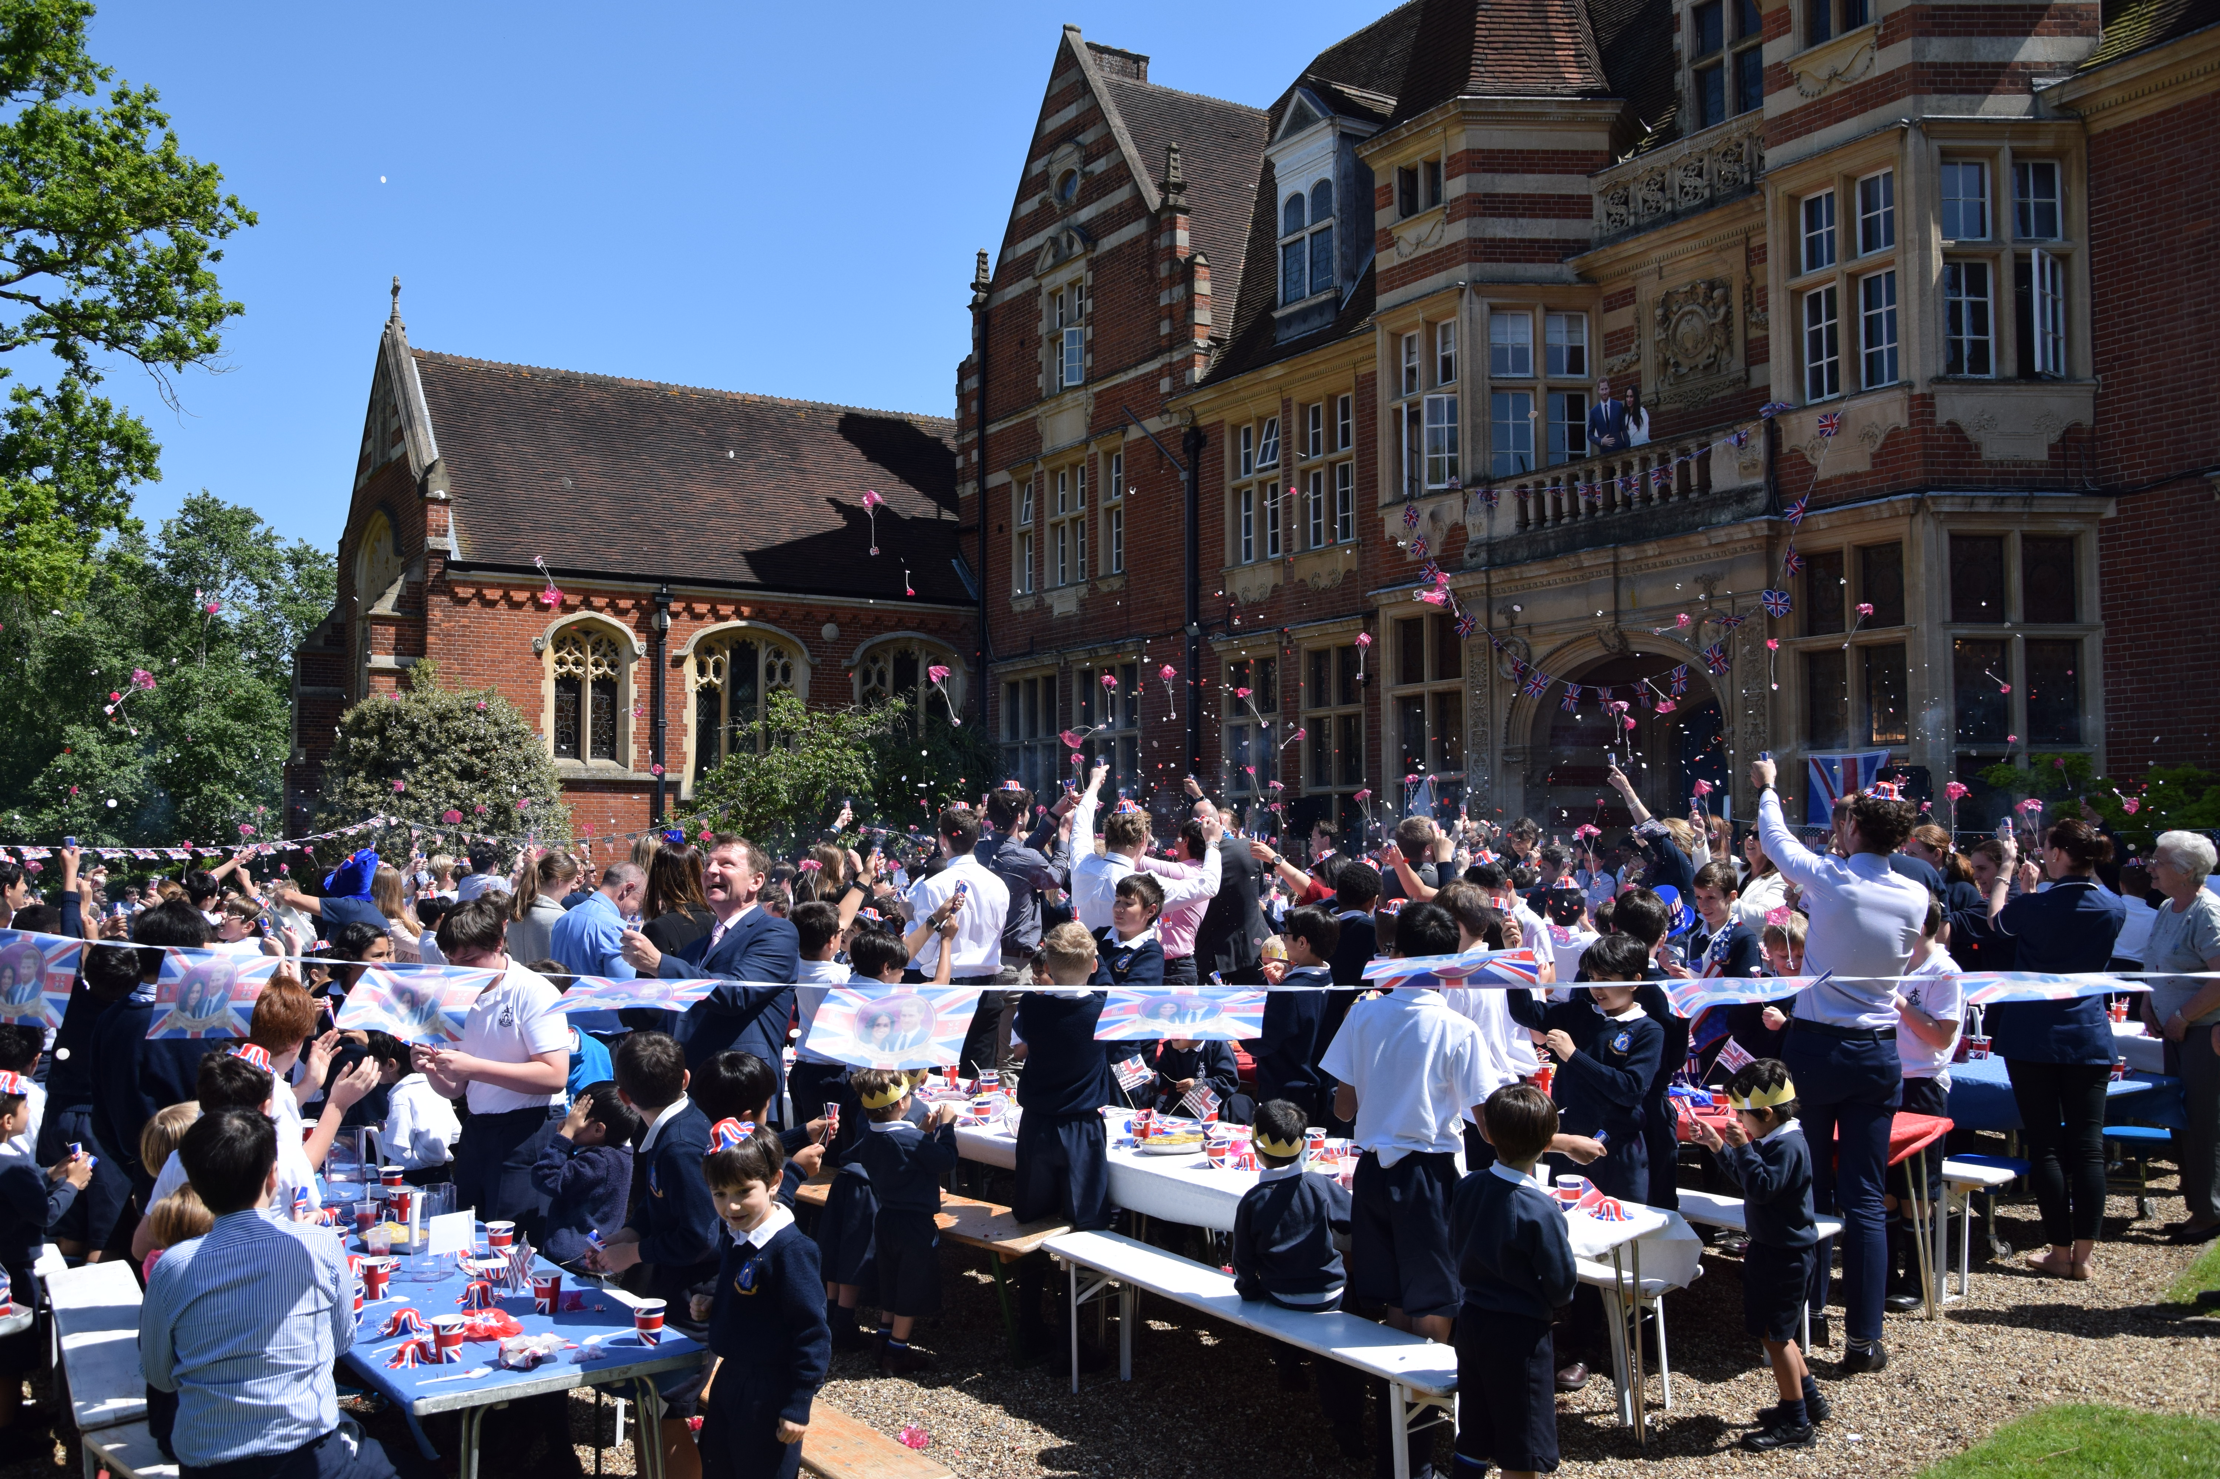
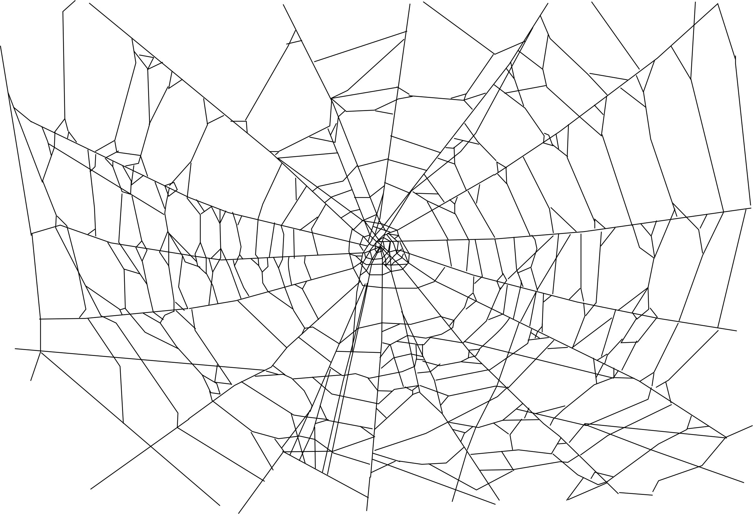

Slide 3
Faith
Hope
Faith
Hope
Faith
Love
Hope
Love
Love
Hope
Love
Faith
Faith
Love
Love
Hope
Love
Hope
Love
Faith
Faith
Love
Hope
Hope
Hope
Faith

Slide 4
Faith
Hope
Love

Slide 5
Hope
Faith
Love

Slide 6
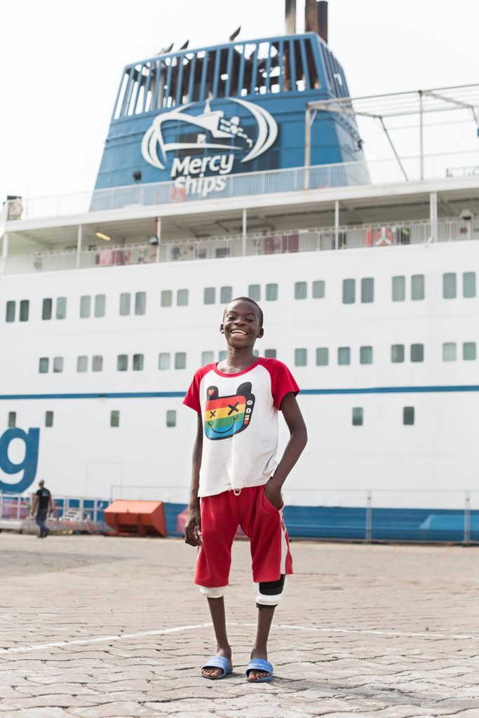
Ulrich

Slide 7


Slide 9
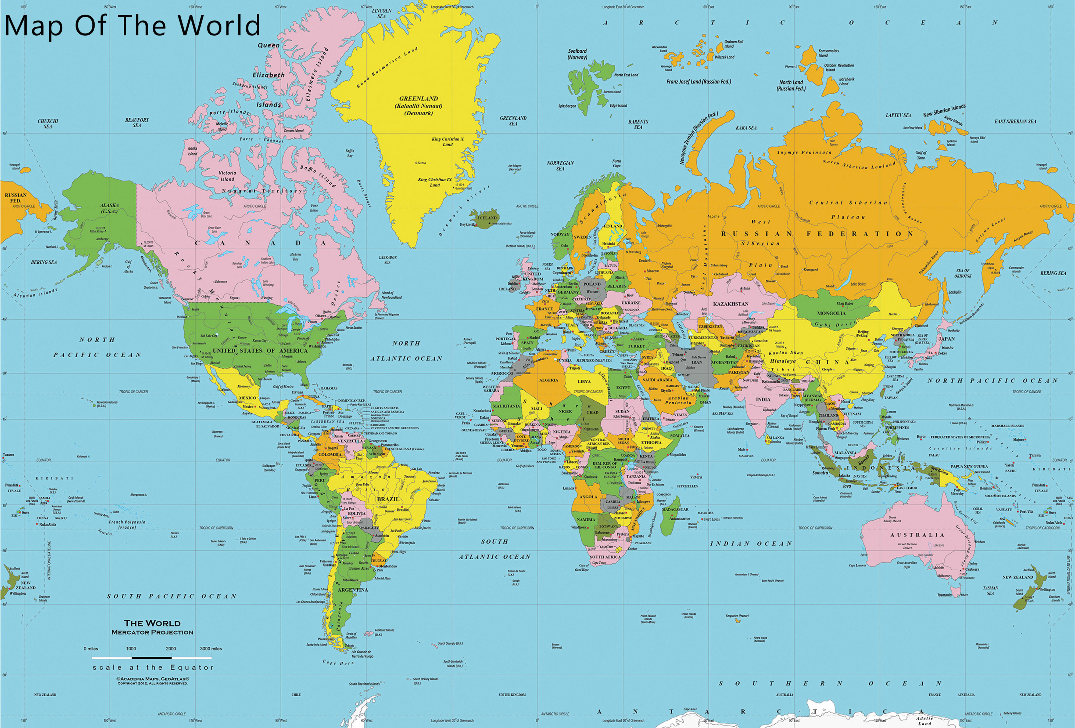

Slide 11
HOPE

Slide 12
Ulrich

Slide 13
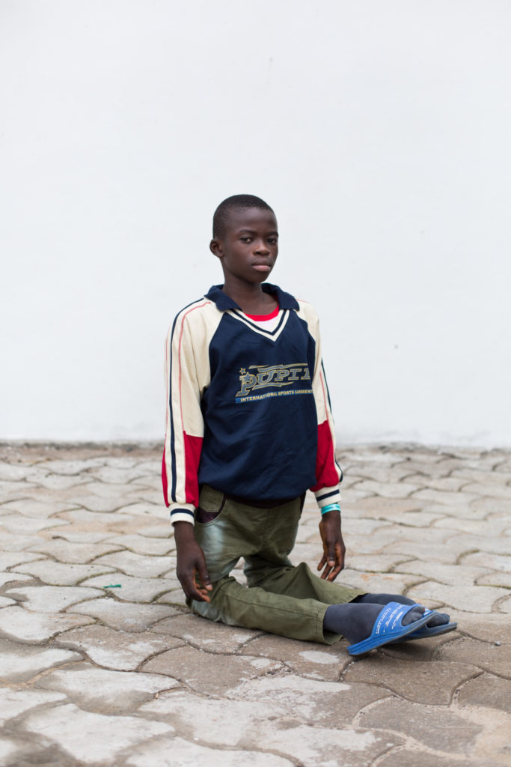
Ulrich

Slide 14
Ulrich
What Do We Stand For?

Slide 15
Faith
Hope
Faith
Hope
Love
Faith
Love
Love
Hope
Hope
Love
Faith
Faith
Love
Hope
Love
Love
Hope
Faith
Faith
Hope
Love
Love
Hope
Hope
Faith

