Slide 1
Introduction:
This assembly aims to encourage pupils to think critically and laterally as well.
It includes the well-known biblical story of Solomon solving a potentially challenging question…how do you know who is telling the truth? The pupils may want to believe both women…but only one is telling the truth and Solomon wants to find out.
Second is a more contemporary problem. In 1991, HM Customs challenged McVities for labelling Jaffa Cakes as ‘cakes’ and not ‘biscuits’. Cakes carried no VAT whereas biscuits carried VAT and the government wanted their money. In the famous case, McVities ‘proved’ they were cakes (after spending millions on lawyers fees!) through a very simple question…
It is widely accepted that when left out for an extended period of time, cakes go hard and biscuits go soft!
Jaffa cakes went hard and McVities won the case!
The question to children might be, how do they begin to solve some of the challenging issues in their lives (e.g. on the playground)…McVities solved it by asking a very well thought-out question, not by threatening the government.
Something else to be discerning about…
The final one-tonne challenge is something fun you might want to start at your school. The production of meat and particularly beef creates millions of tonnes of methane every year, through cows passing wind. You can encourage the children to work out (in maths) how much methane a cow would produce in a year and they could then work out how much methane the school might save if they ate less meat (either in school or home)…

Slide 2
DIS
CERNING

Slide 3
DIS
CERNING
Dis = “off” or “away”
cernere means “separate” or “sift”

Slide 4
DIS
CERNING
Dis = “off” or “away”
cernere means “separate” or “sift”
Discerning comes from the 2 Latin words DIS and CERNERE. People who are discerning are observant and can sift and separate information and focus on the parts that are important or truthful.

Slide 5
SOLOMON
The Reading is taken from the 1st Book of Kings, chapter 3
Now two prostitutes came to the king and stood before him. One of them said, “Pardon me, my lord. This woman and I live in the same house, and I had a baby while she was there with me. The third day after my child was born, this woman also had a baby. We were alone; there was no one in the house but the two of us. “During the night this woman’s son died because she lay on him. So she got up in the middle of the night and took my son from my side while I your servant was asleep. She put him by her breast and put her dead son by my breast. The next morning, I got up to nurse my son—and he was dead! But when I looked at him closely in the morning light, I saw that it wasn’t the son I had borne.”
The other woman said, “No! The living one is my son; the dead one is yours.”
But the first one insisted, “No! The dead one is yours; the living one is mine.” And so they argued before the king.
The king said, “This one says, ‘My son is alive and your son is dead,’ while that one says, ‘No! Your son is dead and mine is alive.’”
Then the king said, “Bring me a sword.” So they brought a sword for the king. He then gave an order: “Cut the living child in two and give half to one and half to the other.”
The woman whose son was alive was deeply moved out of love for her son and said to the king, “Please, my lord, give her the living baby! Don’t kill him!”
But the other said, “Neither I nor you shall have him. Cut him in two!”
Then the king gave his ruling: “Give the living baby to the first woman. Do not kill him; she is his mother.”
https://www.youtube.com/watch?v=0seKLR_oC3s&t=153s (KS 1 & 2: START AT 3 min and 18 secs)
https://www.youtube.com/watch?v=VevmxOc22jg (KS 3 & 4. mentioned the word “prostitute”

Slide 6
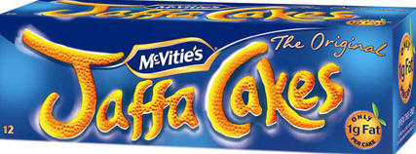
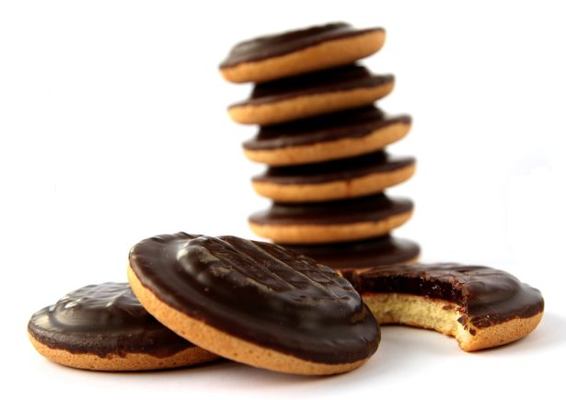
Cake
…or
Biscuit?

Slide 7
CHALLENGE

